Slide 1
Maintaining Security in Deployed Software
Monitor and Log Applications to Support Security
Maintain Security After Deployment

Slide 2
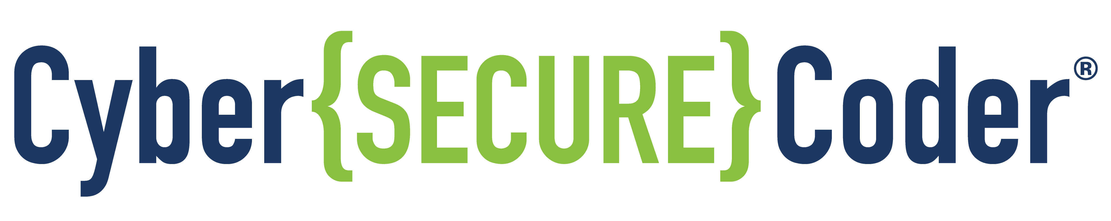
Monitor and Log Applications to Support Security

Slide 3

Emerging Security Problems
Once you have deployed an application, your biggest risk may be complacence.
You may become aware of security compromises:
After there’s a problem—when significant damage has been done.
Before there’s a problem—reveal new vulnerabilities through active testing and monitoring.
Various events can introduce new vulnerabilities over time, such as:
Updates to host platforms.
Configuration of servers and networks being changed inadvertently or on purpose.
Users making changes to content or configuration of client software.
New exploit and attack techniques.

Slide 4


Situational Awareness
Your ability to maintain the security of your application depends largely on your being aware of problems as they arise.
Channels to obtain that information include such sources as:
Active monitoring and scanning of logs to reveal when attack patterns emerge.
Active scanning of application components and vulnerabilities databases to confirm that all modules have been patched to protect against newly discovered threats.
A bug bounty program to triage and investigate issues reported by users.
Customer feedback and support calls.
Periodic re-testing of the application.

Slide 5

Security Monitoring (Slide 1 of 2)
Falls into two categories:
Passive: Events are logged and examined after they occur.
Active: Events are both logged and responded to continuously in real-time.
Components you can monitor:
System and application logs
Application heartbeats
Intra-application communications
System and service response codes (or lack thereof)
CPU, RAM, disk, network interface, and other resource utilization
Client requests and service responses
Application, system, and network activity
Platform or application configuration changes (especially when running on cloud/web hosts)

Slide 6
Security Monitoring (Slide 2 of 2)
Continuous security monitoring:
Is now the norm for effective security operations.
Must be constant, using automation to ease the burden on administrators.
Requires you do more than occasionally scan logs or only scan after an event is detected.
May combine passive and active monitoring.
Needs to be supplemented with manual monitoring and human oversight.
If you depend only on automated systems, you run the risk of false reporting by systems that are not properly configured or updated.

Slide 7

Intrusion Detection and Prevention
Enable you to automate monitoring of your systems.
Intrusion detection system (IDS):
Passive system that logs unauthorized activities on both the network and hosts.
Intrusion prevention system (IPS):
In addition to detection, responds to suspicious activity—e.g., blocking offending traffic.
Network administrator must ensure that legitimate traffic is not accidentally blocked.
These systems may monitor network traffic, access to resources on host computers, or both.
With intrusion detection and prevention systems, you must be concerned about false alarms.
 | Alarm | Silence
True Alarm | True Positive: Alarm sounds during actual incident. | True Negative: Alarm silent, and there is no incident.
False Alarm | False Positive: Alarm sounds, although there is no incident. | False Negative: Alarm does not sound, even though there is an actual incident.
May lead system operator to eventually ignore alarms.
May lead to a false sense of security.

Slide 8

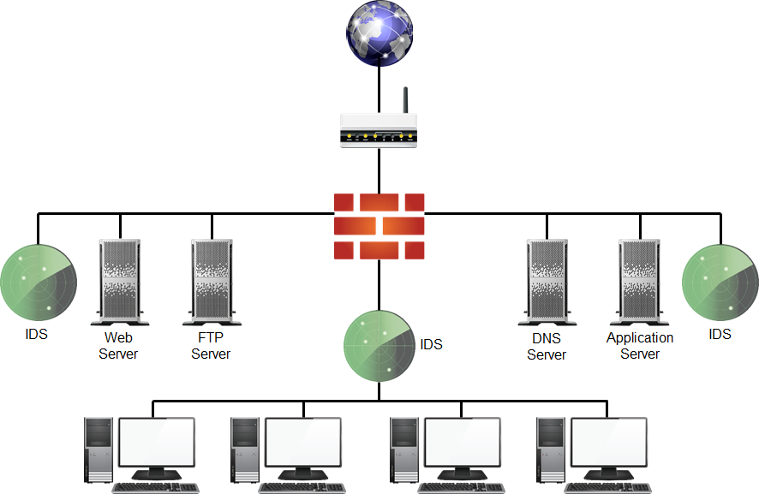



Monitor Placement

Slide 9
Logging
Make sure you log security events.
System operators and security specialists find this information helpful for:
Detecting attacks and other security-related events.
Obtaining data for incident investigation.
Establishing baselines for security monitoring systems.
Tracking repudiation and implementing related controls.
Monitoring policy violations.
Note that this information would also be very instructive to an attacker.
Make sure security logs are stored in a protected area where attackers cannot access them.
Keep process monitoring, auditing, and transaction logs separate from security logs.
Protect communications between IDS/IPS sensors and their console through encryption.

Slide 10

Monitor and Log a Deployed Application (Slide 1 of 2)
Implement a continuous monitoring program to support proactive security in your organization.
Be aware of the danger of false positives and false negatives in intrusion detection systems.
Place intrusion detection and prevention systems directly behind firewalls, dual-homed proxies, routers, and VPN servers.
Place intrusion detection and prevention systems next to single-homed proxies, servers, and wireless access points.

Slide 11
Monitor and Log a Deployed Application (Slide 2 of 2)
Ensure that servers that don't need Internet access (for example, databases) aren't public-facing.
Protect system logs from unauthorized access.
Provide logging of application-specific security information, such as:
Application-level authentication and authorization
Actions performed in the application
Targets of those actions
Outcomes

Slide 12


Activity: Monitoring and Logging a Deployed Application
You will:
Examine a Python example program to see how a logging class might be implemented.
Consider how to determine what sorts of events should be logged.

Slide 13
Maintain Security After Deployment

Slide 14
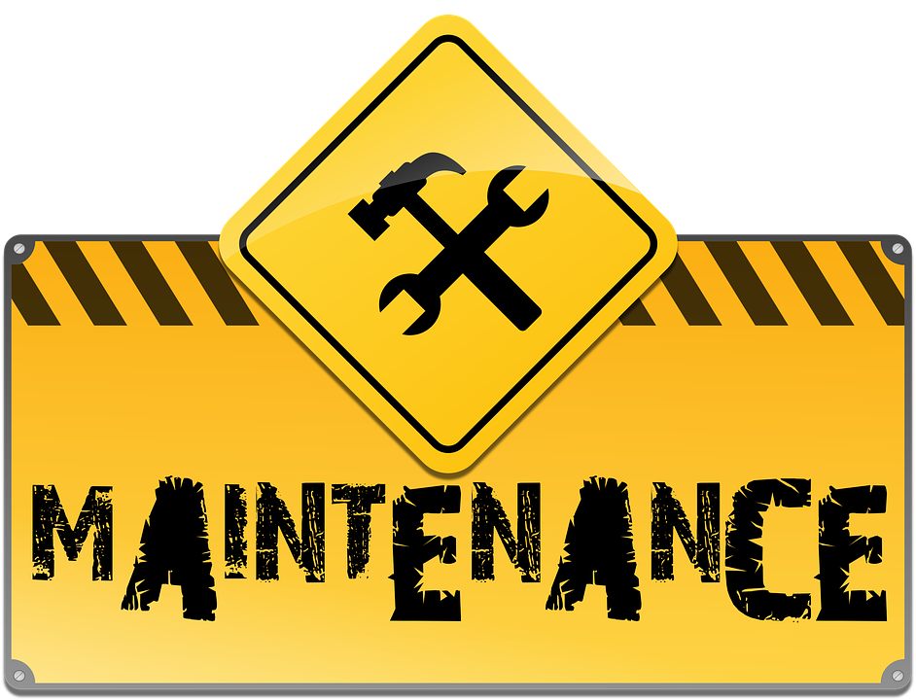
Maintenance (Slide 1 of 2)
The development team:
May not be who sets up and maintains the software.
May have to create documentation, operations procedures, and tools to equip the system operators.
If the operations team is not adequately informed in the proper maintenance of the application:
The application may have security vulnerabilities.
System operators and end users may be frustrated.
Productivity may be lost.
Operations documentation should clearly identify:
Security and privacy controls that should be in place to protect users, data, logging, configuration, and the system.
The process for maintaining and managing software versions.

Slide 15
Maintenance (Slide 2 of 2)
Vulnerabilities and protections should have been documented as part of design and development process.
Much of this information can be reused in documentation provided to the system operations team.
Maintenance tasks vary widely depending on the project, platform, user base, and so forth.
Corrective Maintenance
Adaptive Maintenance
Perfective Maintenance
Preventive Maintenance

Slide 16

Patches and Updates (Slide 1 of 2)
Affect you from two directions:
Incoming
Issued by third-party developers for platforms and other dependencies your software uses.
May resolve vulnerabilities found in the components that your application uses.
May lead you to release patches and updates to your own customers to incorporate improved components into your own software.
Outgoing
Those that you release to your customers to issue changes to the software you developed.
Fixes for problems in your own code.
Feature upgrades.
All of these changes add complexity to the problem of ensuring a secure system.

Slide 17
Patches and Updates (Slide 2 of 2)
Be sure to update any modules your code depends on.
Run regression tests to make sure patches didn’t break anything.
You'll need to have a process in place to determine when and how to issue changes.
Digitally sign your application updates.
Provide a SHA hash alongside the update to assure users the update wasn’t tampered with.

Slide 18

Uninstallation and Deprovisioning (Slide 1 of 2)
Scenarios in which you might inadvertently leave sensitive data—when you:
Uninstall an application from a user's mobile device or computer.
Remove plug-in modules, extensions, or device drivers from a device.
Remove a virtual machine or halt a temporary process on a cloud platform.
You may have to take steps to thoroughly and completely remove all data so that it cannot be recovered.
Sanitization
The process of overwriting all data in storage with random or zero bits to make it very difficult or impossible to recover.
Some systems, like some cloud storage services, may do this automatically.

Slide 19
Uninstallation and Deprovisioning (Slide 2 of 2)
Make sure that you understand how the uninstallation/deprovisioning process works to ensure that no sensitive data is left behind.
Some operating systems (e.g., iOS and Android) remove application storage automatically when you uninstall apps.
If you write installation and uninstallation scripts, make sure they leave no sensitive data behind on uninstallation.

Slide 20


Maintaining Security of Deployed Software (Slide 1 of 4)
Software
Ensure servers, frameworks, and system components are running the latest approved version and include all patches issued for the version in use.
Change any settings on the host platform that are not secure by default. For example, disable directory listings on a web server.
Prior to deployment, remove all unnecessary functionality and files, including test code and other functionality not intended for deployment.
Disable unnecessary protocols and HTTP methods, such as FTP and WebDAV extensions.

Slide 21
Maintaining Security of Deployed Software (Slide 2 of 4)
Software
Protect any necessary protocols and methods through well-tested authentication and access control features.
Isolate development environments from the production network and provide access only to authorized development and test groups.
May be less secure than production environments.
May provide useful clues regarding the state of your production system to an attacker performing reconnaissance.

Slide 22
Maintaining Security of Deployed Software (Slide 3 of 4)
Software
Script your deployments to avoid manual errors, but always verify deployments through human review and signoff.
Strive to continuously improve your development processes, to make them more mature over time. For example, as security problems emerge, address them in a timely manner, but then follow up to determine if there is a root cause within your development processes. If so, revise your development processes as needed.
Ensure that the development team creates a run book, which the operations team can use to manage deployed software.

Slide 23
Maintaining Security of Deployed Software (Slide 4 of 4)
Software
Update modules your code depends on.
Provide a SHA hash alongside your updates to assure users that the update is valid.
Put into place a change management process to reduce risk when the IT environment changes.
Perform periodic integrity checks to make sure the system is still functioning as expected.

Slide 24
Activity: Maintaining Security After Deployment
You developed an Android mobile app that:
Helps users maintain a budget of their monthly living expenses.
Works with users' personal financial records, including their salary and mortgage payments.
A user complained about having his private finances posted publicly on the Internet.
He mentioned that he let a friend borrow his SD card.
The user assures you that this friend is trustworthy.
How could this information have leaked?
You discover your app compromised security because it stores this financial information in external storage.
You added the permission WRITE_EXTERNAL_STORAGE to the app's configuration.
When users install the app, they grant your app permission to do this.
The app's code writes financial data out to the SD card.
Because all apps and users can easily access the SD card, anyone on the friend's device or with access to the SD card could have retrieved the data and copied it.

Slide 25
Who should have access to the security logs provided by the types of software you develop?
What processes do you currently have in place to improve development processes when defects are found in software?

